Slide 1

Spotify Tracks Popularity Prediction -Project by Bhakti D.

Slide 2
Spotify is incredibly popular Swedish audio streaming and media service provider and it is one of the largest music streaming service providers with over 406 million monthly active users180 million paying subscribers. I am going to apply machine learning classification algorithms to predict the popularity of tracks and pick the best algorithm based on success metrics.
Objective – Predict the popularity of tracks based on several independent features. This is a binary classification Problem where popularity will be predicted in two classes to check with given inputs the track will be popular or unpopular. Models Used for Prediction:
Logistic Regression
XG-Boost
K-Nearest Neighbors
Support Vector Machine (SVM)
Decision Tree Classification
Random Forest Classification
Data –
Source - “Spotify Tracks data | Kaggle”
This dataset contains 586672 rows and 20 columns. Out of 20 features, popularity is the (dependent) target feature and rest are independent features.

Slide 3
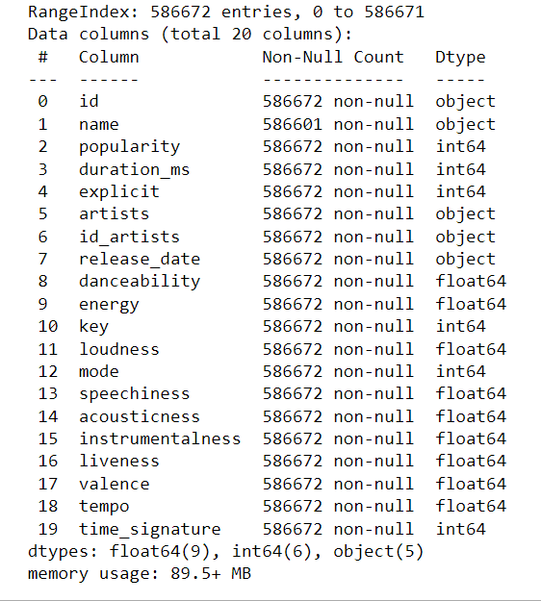
Information about the tracks –
9 float columns – danceability, energy, loudness, speechiness, accousticness, instrumentalness, liveness, valence, tempo
6 integer column – popularity [target feature],duration_ms, explicit, key, mode, time_signature
5 object columns – id,name,artists,id_artists,release_date

Slide 4
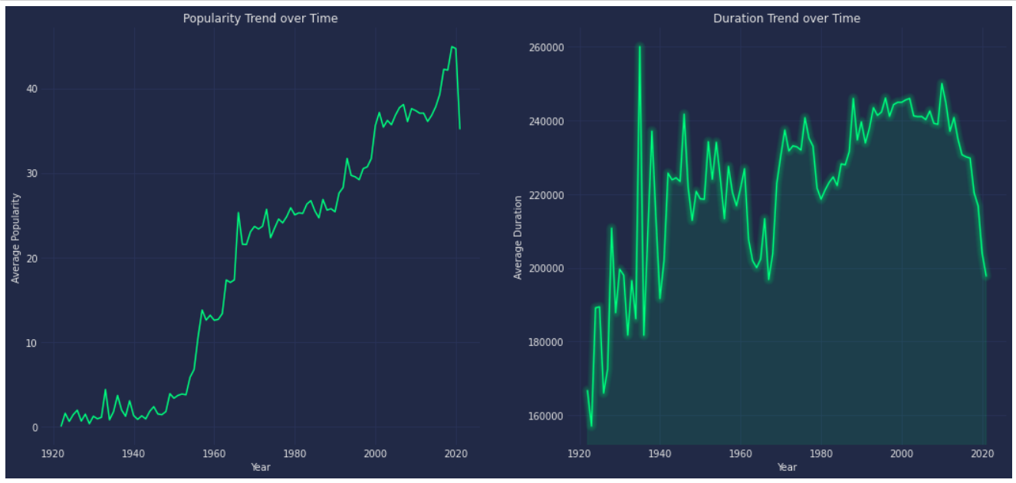
Popularity Trend Over the Time Duration Trend over the Time
There is increasing trend over the years and sudden growth in popularity in late 1950s to early 1970s.
Sudden drop in popularity in the year 2020 and early 2021.Pandemic might be the reason behind this.
Duration of tracks increased suddenly between 1930 and 1940.
Since 2015, Duration of Tracks has taken a fall.

Slide 5
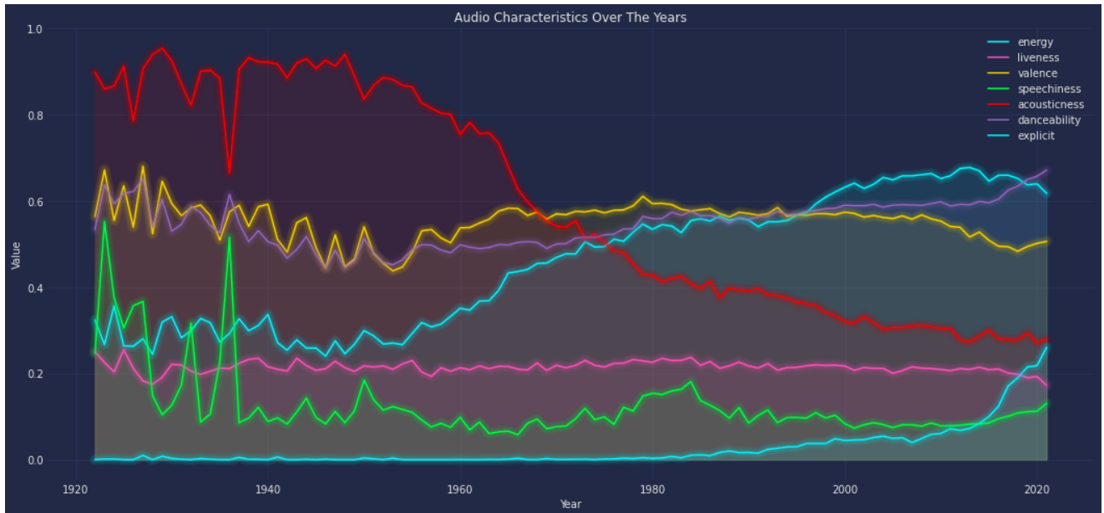
Audio Characteristics over the Years
Acousticness of Tracks has declined over the years while 'Energy' of the Tracks has significantly increased over the Years.
Valence has become quite stable after 1962.
Speechiness of tracks was higher in the initial years i.e. from 1920, however it kept decreasing 1937 and stayed below 0.2
Danceability has varied significantly but has stayed mostly increased since 1980.
Explicit Tracks can be seen increasing after late 1980s and have significantly increased since then.

Slide 6
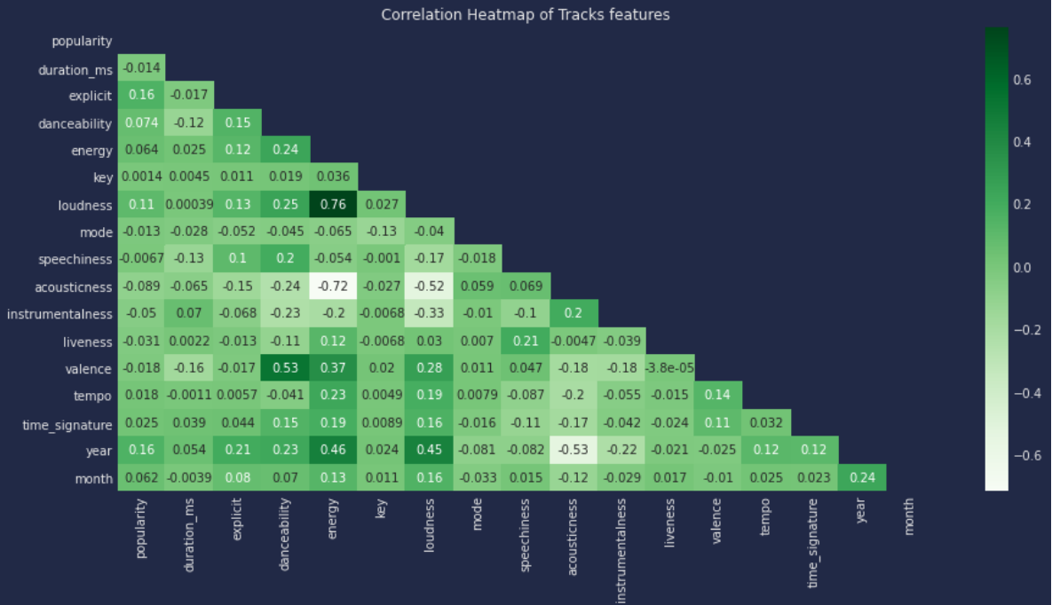
Correlation Heatmap of Tracks’ Features
Energetic tracks have high positive correlation with Loudness (0.76)
Valence and danceability has positive correlation(0.53)
Acousticness and Energy have highly negative correlation(-0.72)
Popularity is positively correlated with the year. (0.59)
Acoustiness is negatively correlated with popularity, duration, explicit, danceability, energy, key and loudness. Most popular songs today have either electronic or electric instruments in them.

Slide 7
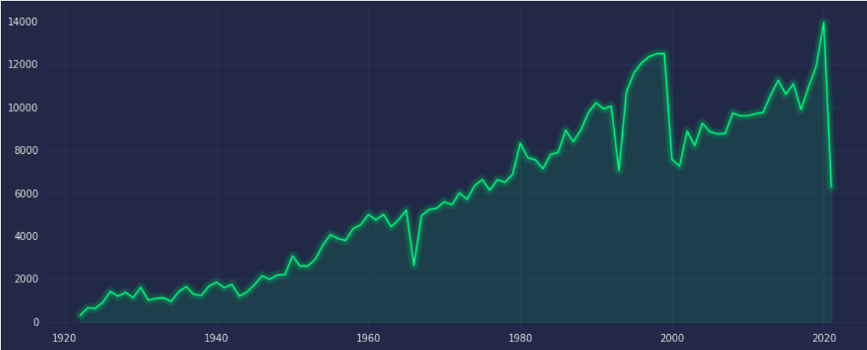
Trend of released tracks over the Years
In the initial years i. e. 1920, less no. of tracks were released, since then the trend increased
In the year 2020, the most no. of tracks were released.

Slide 8
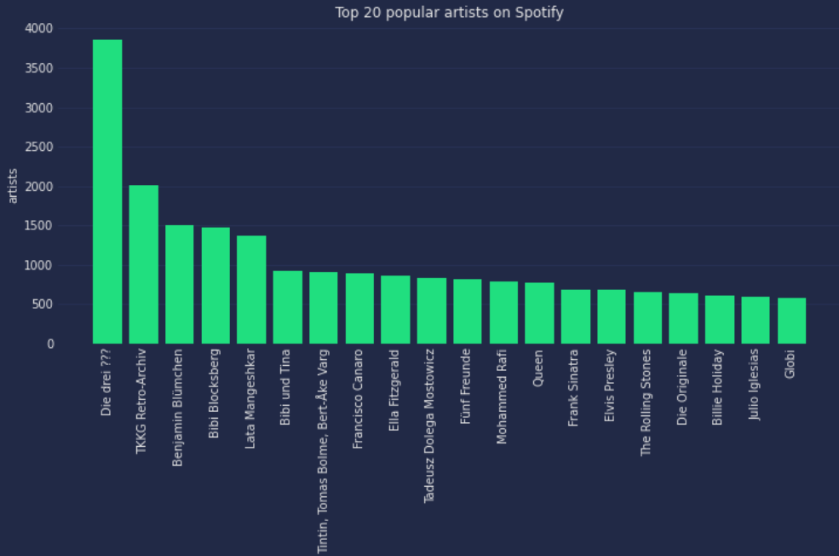
Top 20 Popular Artists on Spotify
Die drei ??? , TKKG Retro –Archiv, Benjamin, Bibi and Lata Mangeshkar lists the top 5 artists on spotify.

Slide 9
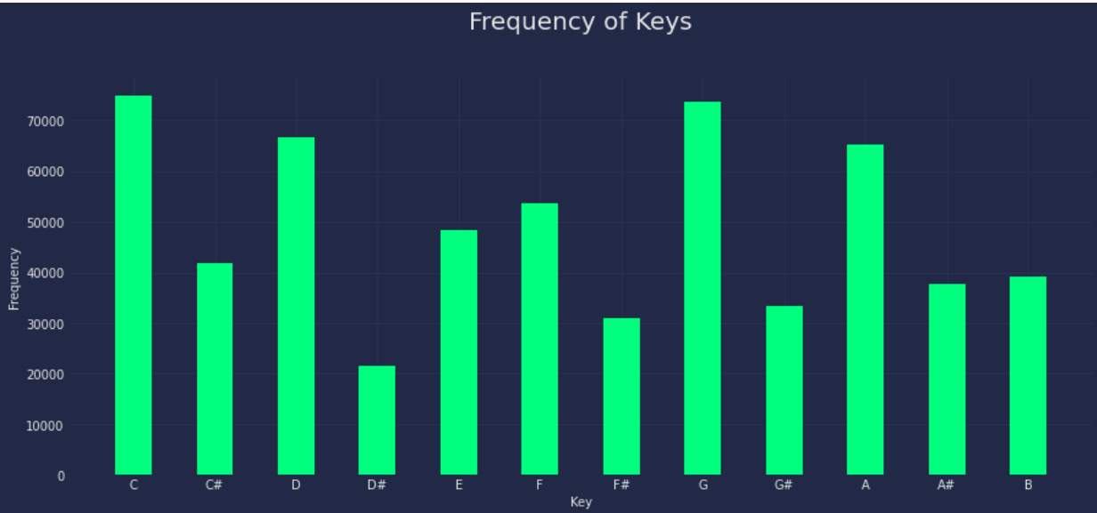
Frequency of Keys
Majority tracks were made in the C,G and D keys.
Very few tracks have been composed with D# Keys

Slide 10
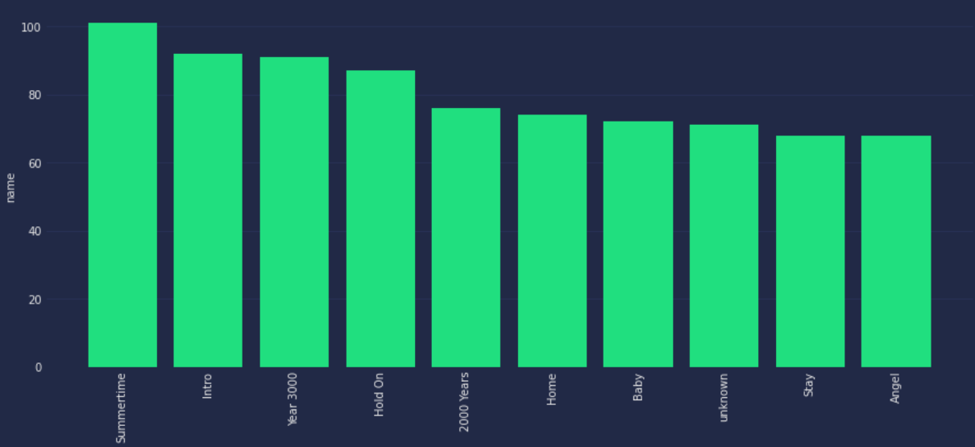
Top 10 most popular Tracks
-Summertime is the most popular track, followed by intro, Year 3000 and so on.......

Slide 11
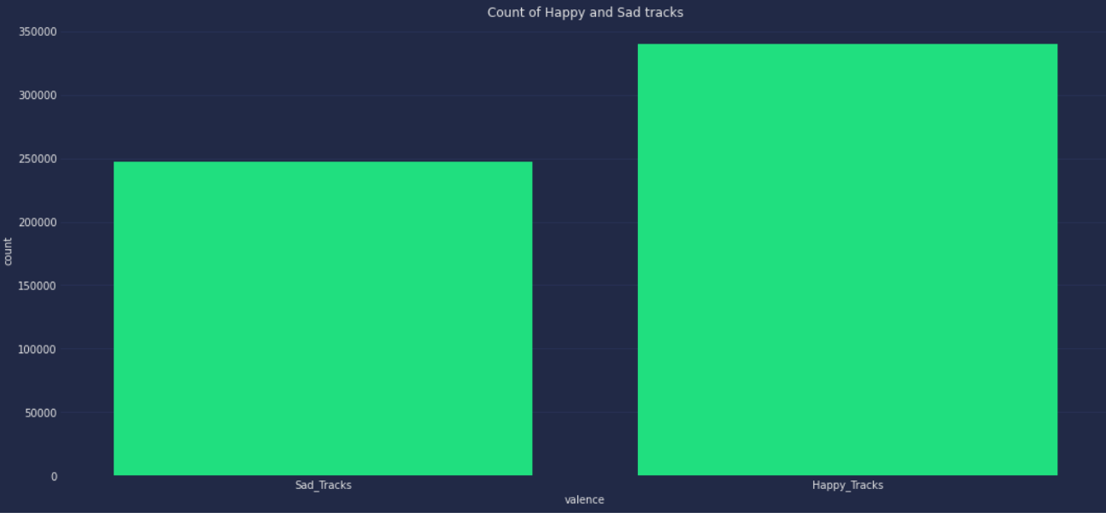
Count of Happy Tracks and Sad Tracks
Count of Happy and Sad tracks
Happy Tracks = 339666
Sad Tracks = 246999

Slide 12
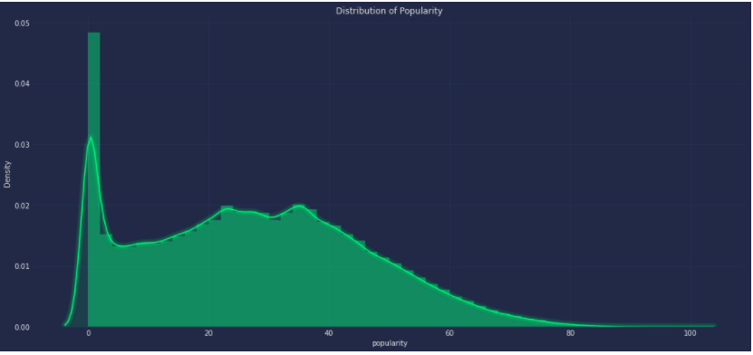
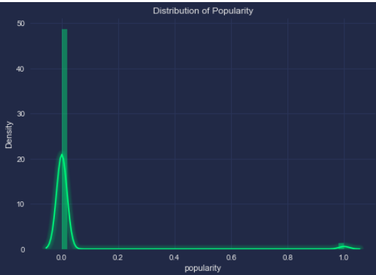
Popularity Distribution before preprocessing
Popularity Distribution after preprocessing

Slide 13
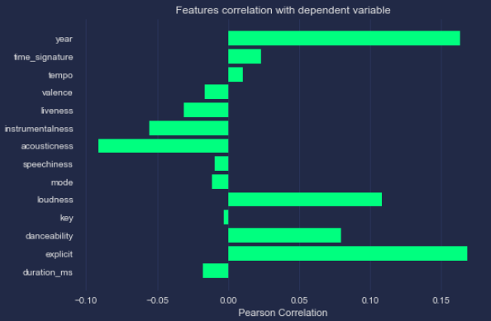
Features Correlation with dependent variable
There are 6 features which are positively correlated and 8 features are negatively correlated with the dependent feature.

Slide 14
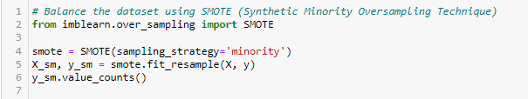
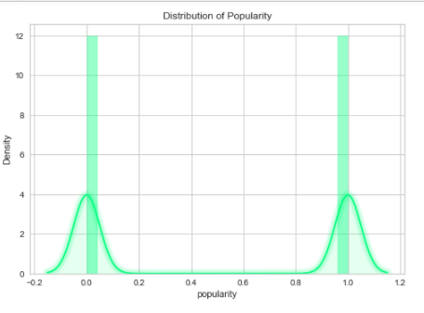
Balance the popularity feature using SMOTE
Synthetic Minority Oversampling Technique (SMOTE) is a statistical technique for increasing the number of cases in the dataset in a balanced way.

Slide 15
Apply Machine Learning Classification Algorithms
1. Logistic Regression - Logistic regression is a classification algorithm used to assign observations to a discrete set of classes. Unlike linear regression which outputs continuous number values, logistic regression transforms its output using the logistic sigmoid function to return a probability value which can then be mapped to two or more discrete classes.
Model Accuracy score – 78%
2. Decision Tree Classifier - Decision Tree is a Supervised learning technique that can be used for both classification and Regression problems, but mostly it is preferred for solving Classification problems. It is a tree-structured classifier, where internal nodes represent the features of a dataset, branches represent the decision rules and each leaf node represents the outcome.
Model Accuracy score – 89%
3. Random Forest Classifier - is a supervised learning algorithm which you can use for regression and classification problems. It consists of multiple decision trees. Assuming your dataset has “m” features, the random forest will randomly choose “k” features where k < m. Now, the algorithm will calculate the root node among the k features by picking a node that has the highest information gain.
Model Accuracy score – 95%

Slide 16
Apply Machine Learning Classification Algorithms
4. KNN - K-Nearest Neighbour is one of the simplest Machine Learning algorithms based on Supervised Learning technique. It assumes the similarity between the new case/data and available cases and put the new case into the category that is most similar to the available categories.
Model Accuracy score – 89%
XGB Classifier - XGBoost is a gradient boosting algorithm. XGBoost the Algorithm operates on decision trees, models that construct a graph that examines the input under various “if” statements (vertices in the graph). Whether the “if” condition is satisfied influences the next “if” condition and eventual prediction. XGBoost the Algorithm progressively adds more and more “if” conditions to the decision tree to build a stronger model.
Model Accuracy score –93%
6. Support Vector Machine - The goal of the SVM algorithm is to create the best line or decision boundary that can segregate n-dimensional space into classes so that we can easily put the new data point in the correct category in the future. This best decision boundary is called a hyperplane.
Model Accuracy score – 86%

Slide 17
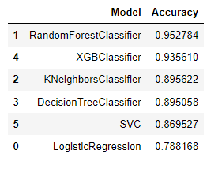
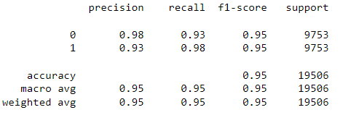
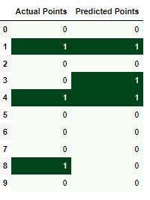
Model Accuracy and Performance
- Out of all the classification models, Random Forest has given the maximum accuracy.
- Model can predict 95% accurate results predicting the track is popular or not
There is 95% F1 score of precision and recall.
Visual display of Actual and Predicted Points

Slide 18
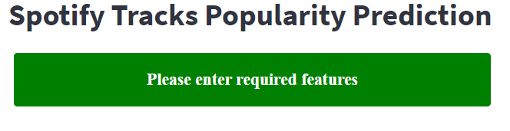
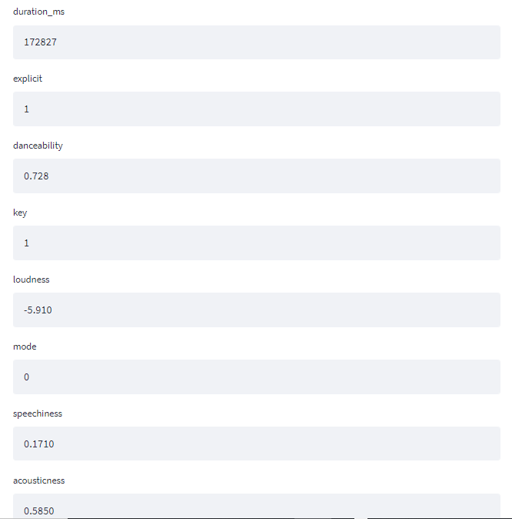
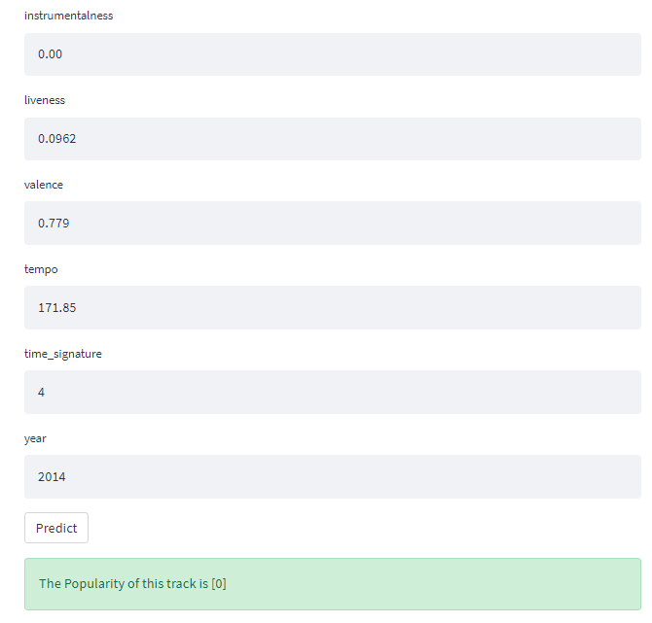
Web App of Spotify Model - Streamlit
Thank you …….

